Slide 1
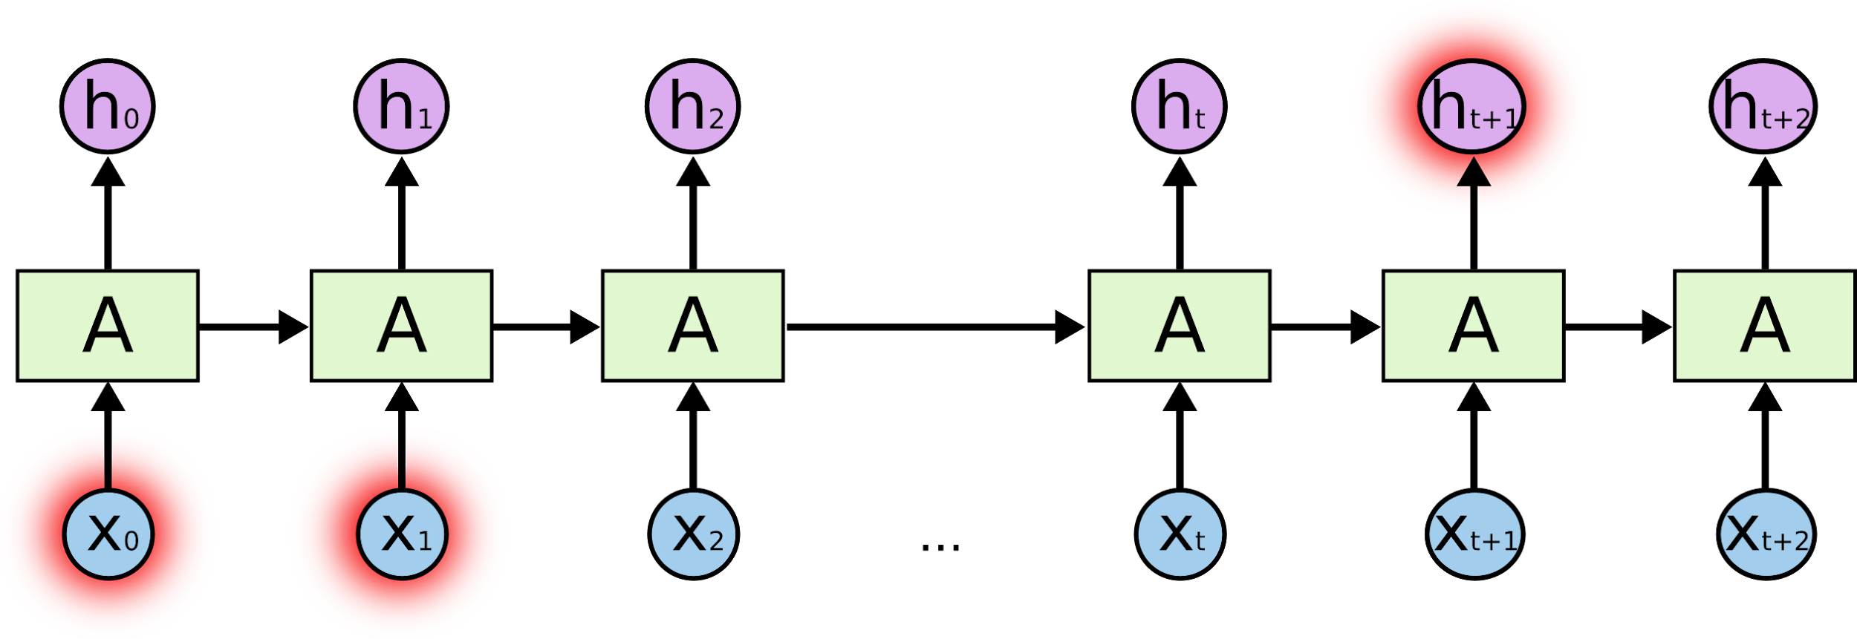


Lab 12
RNN
With PyTorch 0.2.0_2
Sung Kim <hunkim+ml@gmail.com>
Code: https://github.com/hunkim/DeepLearningZeroToAll/

Slide 2
Lab 12-1
Hi Hello RNN
With PyTorch 0.2.0_2
Sung Kim <hunkim+ml@gmail.com>
Code: https://github.com/hunkim/DeepLearningZeroToAll/

Slide 3
https://github.com/hunkim/DeepLearningZeroToAll/tree/master/pytorch
https://github.com/hunkim/DeepLearningZeroToAll/blob/master/pytorch/lab-12-1-hello-rnn.py

Slide 4
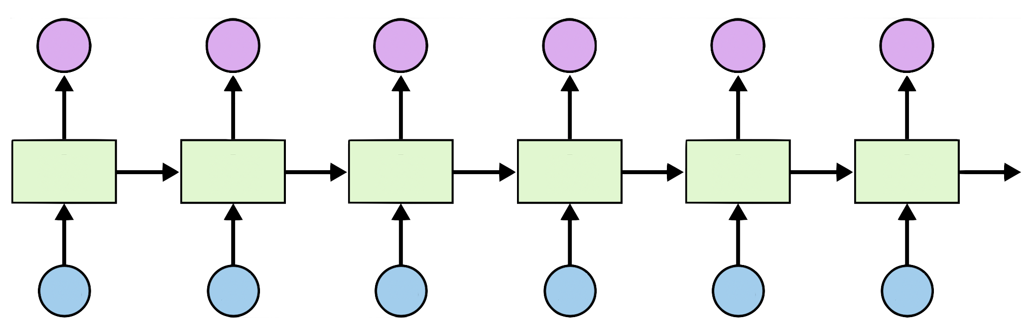
Teach RNN ‘hihello’
i
h
e
l
l
o
h
i
h
e
l
l

Slide 5
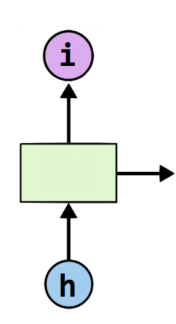
One-hot encoding
text: ‘hihello’
unique chars (vocabulary, voc):
h, i, e, l, o
voc index:
h:0, i:1, e:2, l:3, o:4
[1, 0, 0, 0, 0], # h 0
[0, 1, 0, 0, 0], # i 1
[0, 0, 1, 0, 0], # e 2
[0, 0, 0, 1, 0], # l 3
[0, 0, 0, 0, 1], # o 4

Slide 6
Teach RNN ‘hihello’
[1, 0, 0, 0, 0], # h 0
[0, 1, 0, 0, 0], # i 1
[0, 0, 1, 0, 0], # e 2
[0, 0, 0, 1, 0], # l 3
[0, 0, 0, 0, 1], # o 4
[0, 1, 0, 0, 0]
[1, 0, 0, 0, 0]
[0, 1, 0, 0, 0]
[0, 1, 0, 0, 0]
[0, 1, 0, 0, 0]
[0, 0, 0, 0, 1]
i
h
e
l
l
o
h
i
h
e
l
l
[1, 0, 0, 0, 0]
[0, 1, 0, 0, 0]
[1, 0, 0, 0, 0]
[0, 1, 0, 0, 0]
[0, 1, 0, 0, 0]
[0, 1, 0, 0, 0]

Slide 7
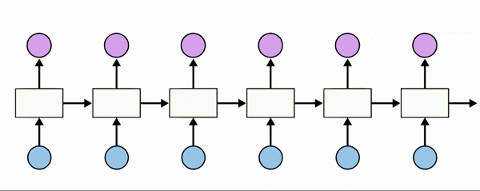
Teach RNN ‘hihello’
[1, 0, 0, 0, 0], # h 0
[0, 1, 0, 0, 0], # i 1
[0, 0, 1, 0, 0], # e 2
[0, 0, 0, 1, 0], # l 3
[0, 0, 0, 0, 1], # o 4

Slide 8
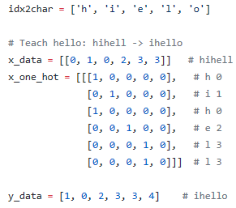
Teach RNN ‘hihello’
https://github.com/hunkim/DeepLearningZeroToAll/blob/master/pytorch/lab-12-1-hello-rnn.py

Slide 9
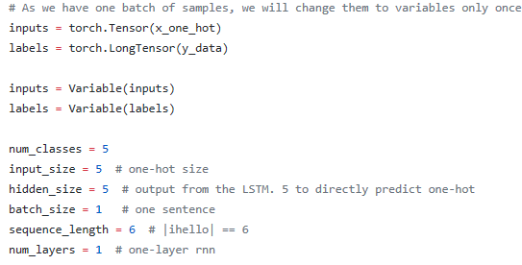
RNN parameters
https://github.com/hunkim/DeepLearningZeroToAll/blob/master/pytorch/lab-12-1-hello-rnn.py

Slide 10
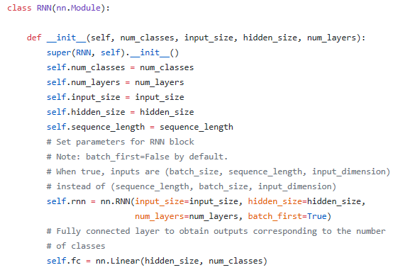
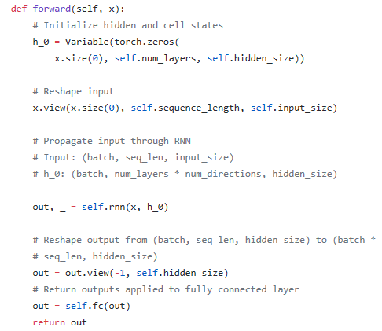
Class RNN
https://github.com/hunkim/DeepLearningZeroToAll/blob/master/pytorch/lab-12-1-hello-rnn.py

Slide 11
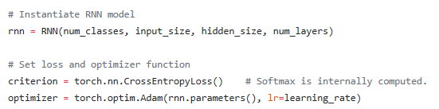
Loss, Optimizer
https://github.com/hunkim/DeepLearningZeroToAll/blob/master/pytorch/lab-12-1-hello-rnn.py

Slide 12
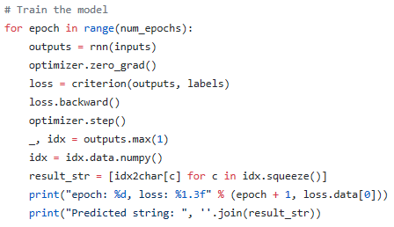
Training
https://github.com/hunkim/DeepLearningZeroToAll/blob/master/pytorch/lab-12-1-hello-rnn.py

Slide 13
Lab 12-2
RNN with long sequences
With PyTorch 0.2.0_2
Sung Kim <hunkim+ml@gmail.com>
Code: https://github.com/hunkim/DeepLearningZeroToAll/

Slide 14
https://github.com/hunkim/DeepLearningZeroToAll/tree/master/pytorch
https://github.com/hunkim/DeepLearningZeroToAll/blob/master/pytorch/lab-12-2-char-seq-rnn.py

Slide 15
Manual data creation
idx2char = ['h', 'i', 'e', 'l', 'o']
x_data = [[0, 1, 0, 2, 3, 3]] # hihell
x_one_hot = [[[1, 0, 0, 0, 0], # h 0
[0, 1, 0, 0, 0], # i 1
[1, 0, 0, 0, 0], # h 0
[0, 0, 1, 0, 0], # e 2
[0, 0, 0, 1, 0], # l 3
[0, 0, 0, 1, 0]]] # l 3
y_data = [[1, 0, 2, 3, 3, 4]] # ihello
https://github.com/hunkim/DeepLearningZeroToAll/blob/master/pytorch/lab-12-1-hello-rnn.py

Slide 16
Better data creation
sample = " if you want you"
idx2char = list(set(sample)) # index -> char
char2idx = {c: i for i, c in enumerate(idx2char)} # char -> idx
https://github.com/hunkim/DeepLearningZeroToAll/blob/master/pytorch/lab-12-2-char-seq-rnn.py

Slide 17
Hyper parameters
sample = " if you want you"
idx2char = list(set(sample)) # index -> char
char2idx = {c: i for i, c in enumerate(idx2char)} # char -> idx
# hyper parameters
dic_size = len(char2idx) # RNN input size (one hot size)
rnn_hidden_size = len(char2idx) # RNN output size
num_classes = len(char2idx) # final output size (RNN or softmax, etc.)
batch_size = 1 # one sample data, one batch
sequence_length = len(sample) - 1 # number of lstm unfolding (unit #)
https://github.com/hunkim/DeepLearningZeroToAll/blob/master/pytorch/lab-12-2-char-seq-rnn.py

Slide 18
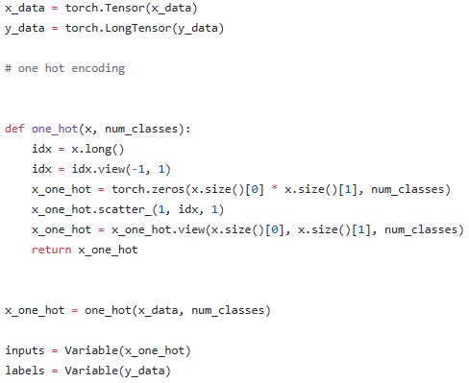
One hot encoding
sample_idx = [char2idx[c] for c in sample] # char to index
x_data = [sample_idx[:-1]] # X data sample (0 ~ n-1) hello: hell
y_data = [sample_idx[1:]] # Y label sample (1 ~ n) hello: ello
https://github.com/hunkim/DeepLearningZeroToAll/blob/master/pytorch/lab-12-2-char-seq-rnn.py

Slide 19
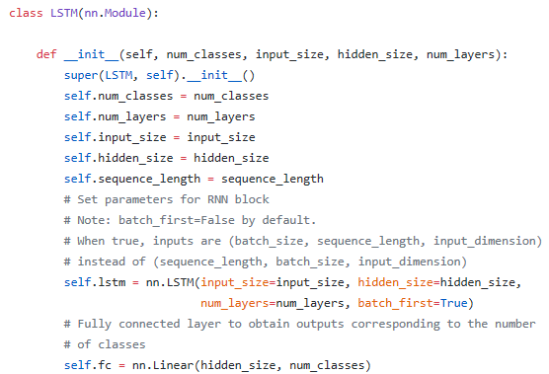
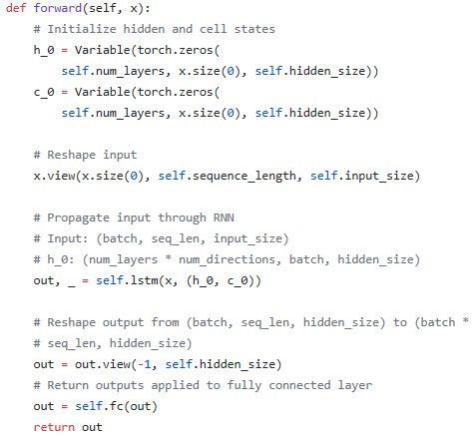
LSTM
https://github.com/hunkim/DeepLearningZeroToAll/blob/master/pytorch/lab-12-2-char-seq-rnn.py

Slide 20
Loss, Optimizer
https://github.com/hunkim/DeepLearningZeroToAll/blob/master/pytorch/lab-12-2-char-seq-rnn.py

Slide 21
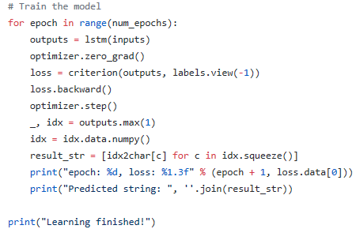
Training
https://github.com/hunkim/DeepLearningZeroToAll/blob/master/pytorch/lab-12-2-char-seq-rnn.py

Slide 22
Lab 12-4
RNN with long sentences
With PyTorch 0.2.0_2
Sung Kim <hunkim+ml@gmail.com>
Code: https://github.com/hunkim/DeepLearningZeroToAll/

Slide 23
https://github.com/hunkim/DeepLearningZeroToAll/tree/master/pytorch
https://github.com/hunkim/DeepLearningZeroToAll/blob/master/pytorch/lab-12-4-rnn-long_char.py

Slide 24
Really long sentence?
sentence = ("if you want to build a ship, don't drum up people together to "
"collect wood and don't assign them tasks and work, but rather "
"teach them to long for the endless immensity of the sea.")
https://github.com/hunkim/DeepLearningZeroToAll/blob/master/pytorch/lab-12-4-rnn-long_char.py

Slide 25
Really long sentence?
sentence = ("if you want to build a ship, don't drum up people together to "
"collect wood and don't assign them tasks and work, but rather "
"teach them to long for the endless immensity of the sea.")
# training dataset
0 if you wan -> f you want
1 f you want -> you want
2 you want -> you want t
3 you want t -> ou want to
…
168 of the se -> of the sea
169 of the sea -> f the sea.
https://github.com/hunkim/DeepLearningZeroToAll/blob/master/pytorch/lab-12-4-rnn-long_char.py

Slide 26
RNN parameters
char_set = list(set(sentence))
char_dic = {w: i for i, w in enumerate(char_set)}
# hyperparameters
learning_rate = 0.1
num_epochs = 500
input_size = len(char_set) # RNN input size (one hot size)
hidden_size = len(char_set) # RNN output size
num_classes = len(char_set) # final output size (RNN or softmax, etc.)
sequence_length = 10 # any arbitrary number
num_layers = 2 # number of layers in RNN
# training dataset
0 if you wan -> f you want
1 f you want -> you want
2 you want -> you want t
3 you want t -> ou want to
…
168 of the se -> of the sea
169 of the sea -> f the sea.
https://github.com/hunkim/DeepLearningZeroToAll/blob/master/pytorch/lab-12-4-rnn-long_char.py

Slide 27
Making dataset
char_set = list(set(sentence))
char_dic = {w: i for i, w in enumerate(char_set)}
dataX = []
dataY = []
for i in range(0, len(sentence) - seq_length):
x_str = sentence[i:i + seq_length]
y_str = sentence[i + 1: i + seq_length + 1]
print(i, x_str, '->', y_str)
x = [char_dic[c] for c in x_str] # x str to index
y = [char_dic[c] for c in y_str] # y str to index
dataX.append(x)
dataY.append(y)
# training dataset
0 if you wan -> f you want
1 f you want -> you want
2 you want -> you want t
3 you want t -> ou want to
…
168 of the se -> of the sea
169 of the sea -> f the sea.
https://github.com/hunkim/DeepLearningZeroToAll/blob/master/pytorch/lab-12-4-rnn-long_char.py

Slide 28
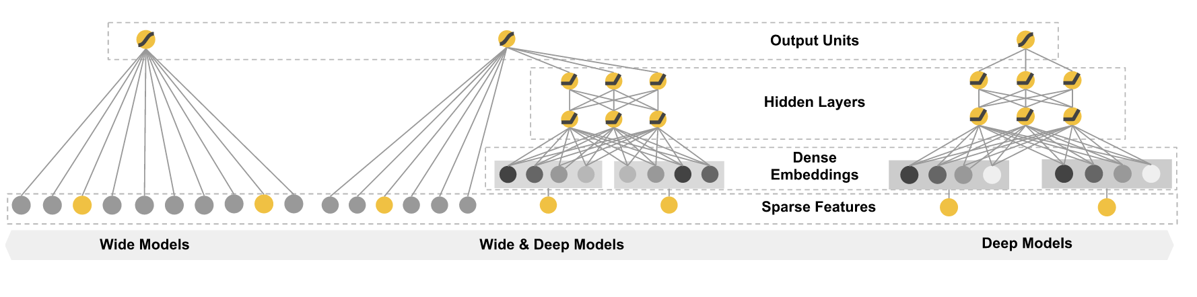
Wide & Deep
https://www.tensorflow.org/versions/r0.11/tutorials/wide_and_deep/index.html

Slide 29
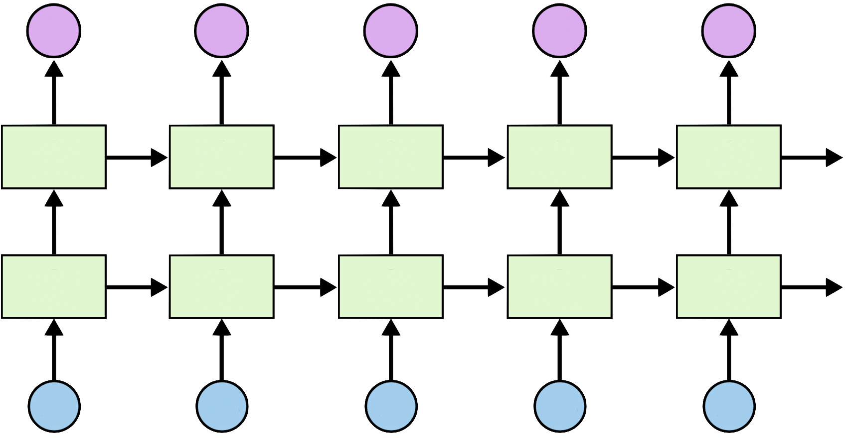
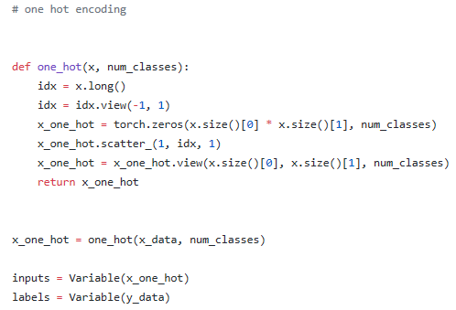
Stacked RNN
https://github.com/hunkim/DeepLearningZeroToAll/blob/master/pytorch/lab-12-4-rnn-long_char.py

Slide 30
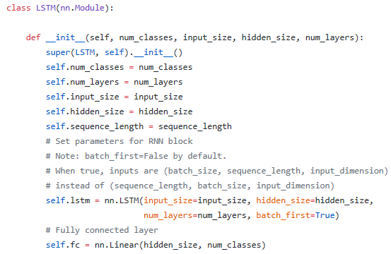
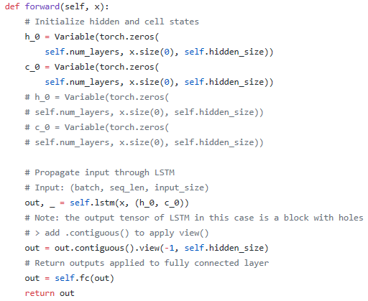
LSTM
https://github.com/hunkim/DeepLearningZeroToAll/blob/master/pytorch/lab-12-4-rnn-long_char.py

Slide 31
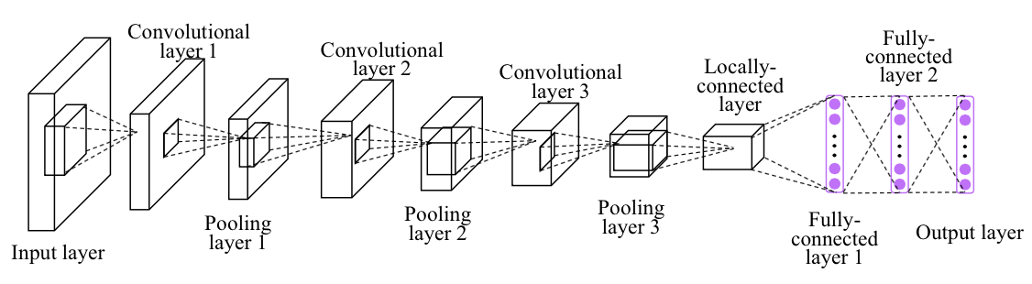
Softmax (FC) in Deep CNN
Image credit: http://personal.ie.cuhk.edu.hk/~ccloy/project_target_code/index.html

Slide 32
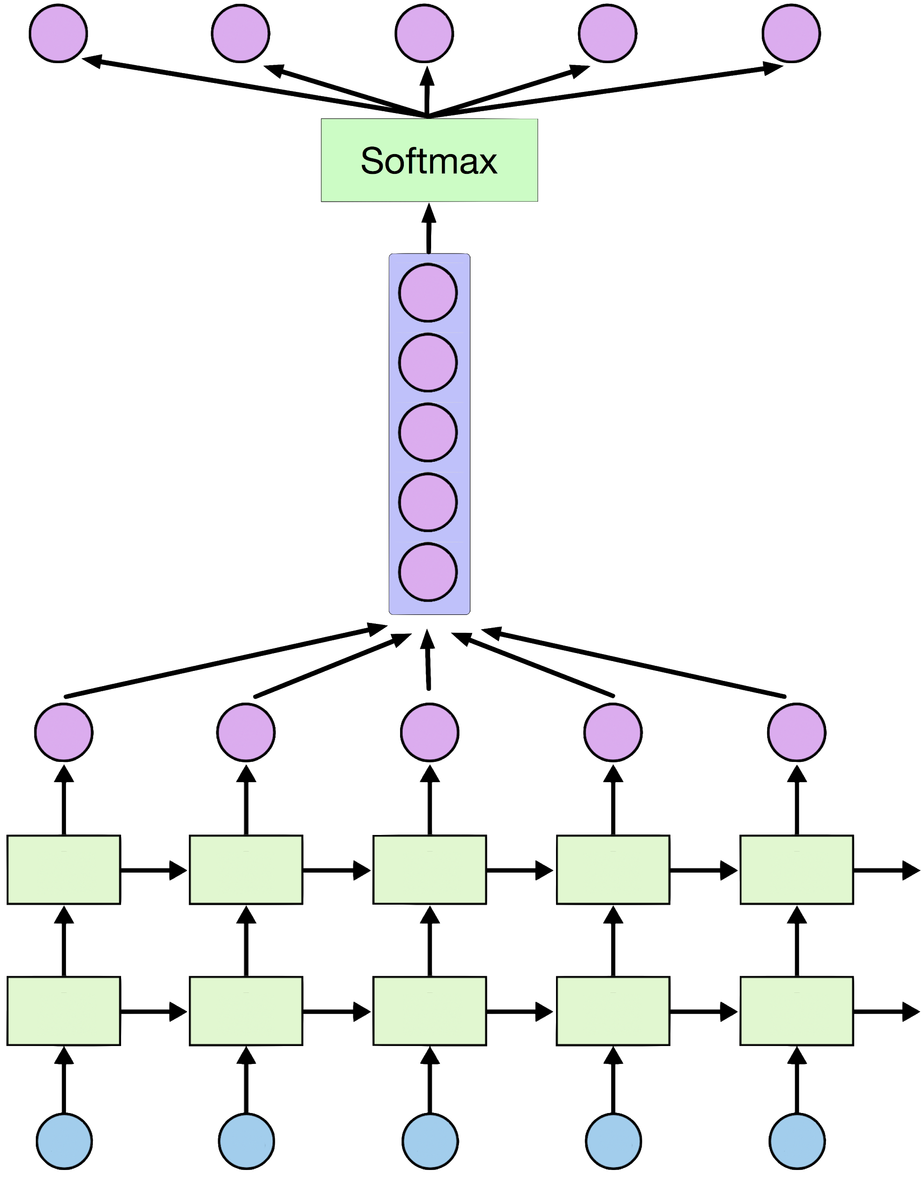
Softmax

Slide 33
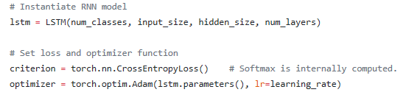
Loss, Optimizer
https://github.com/hunkim/DeepLearningZeroToAll/blob/master/pytorch/lab-12-4-rnn-long_char.py

Slide 34
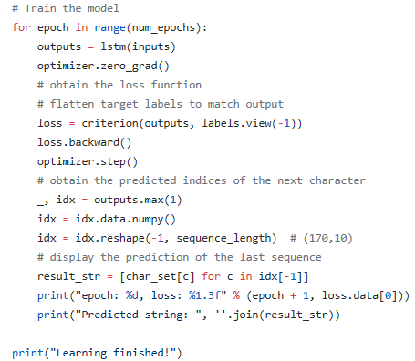
Training
https://github.com/hunkim/DeepLearningZeroToAll/blob/master/pytorch/lab-12-4-rnn-long_char.py

Slide 35
Print results
g you want to build a ship, don't drum up people together to collect wood and don't assign them tasks and work, but rather teach them to long for the endless immensity of the sea.

Slide 36
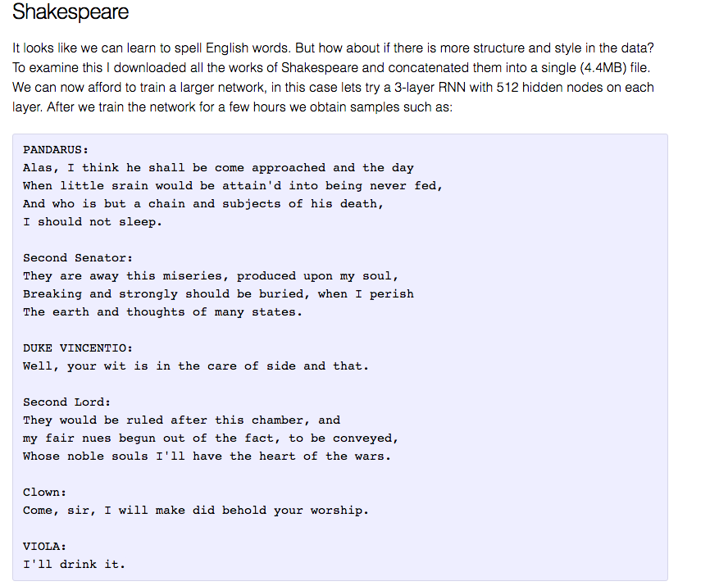
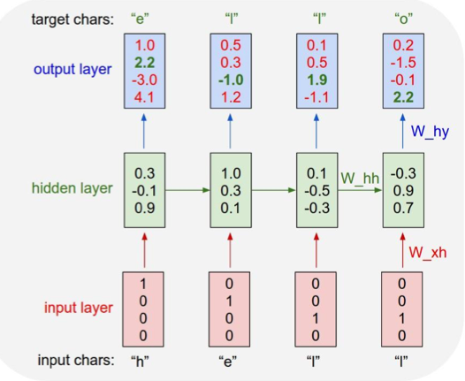
char-rnn
http://karpathy.github.io/2015/05/21/rnn-effectiveness/

Slide 37
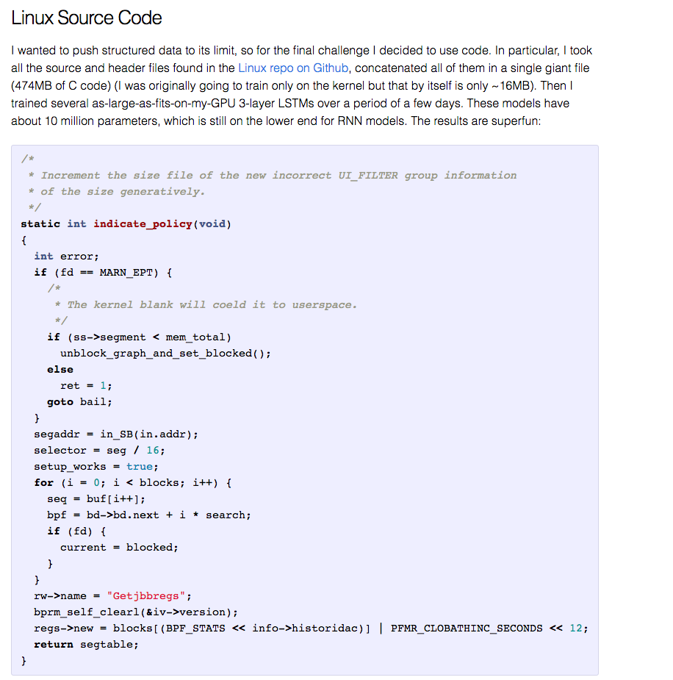
http://karpathy.github.io/2015/05/21/rnn-effectiveness/

Slide 38
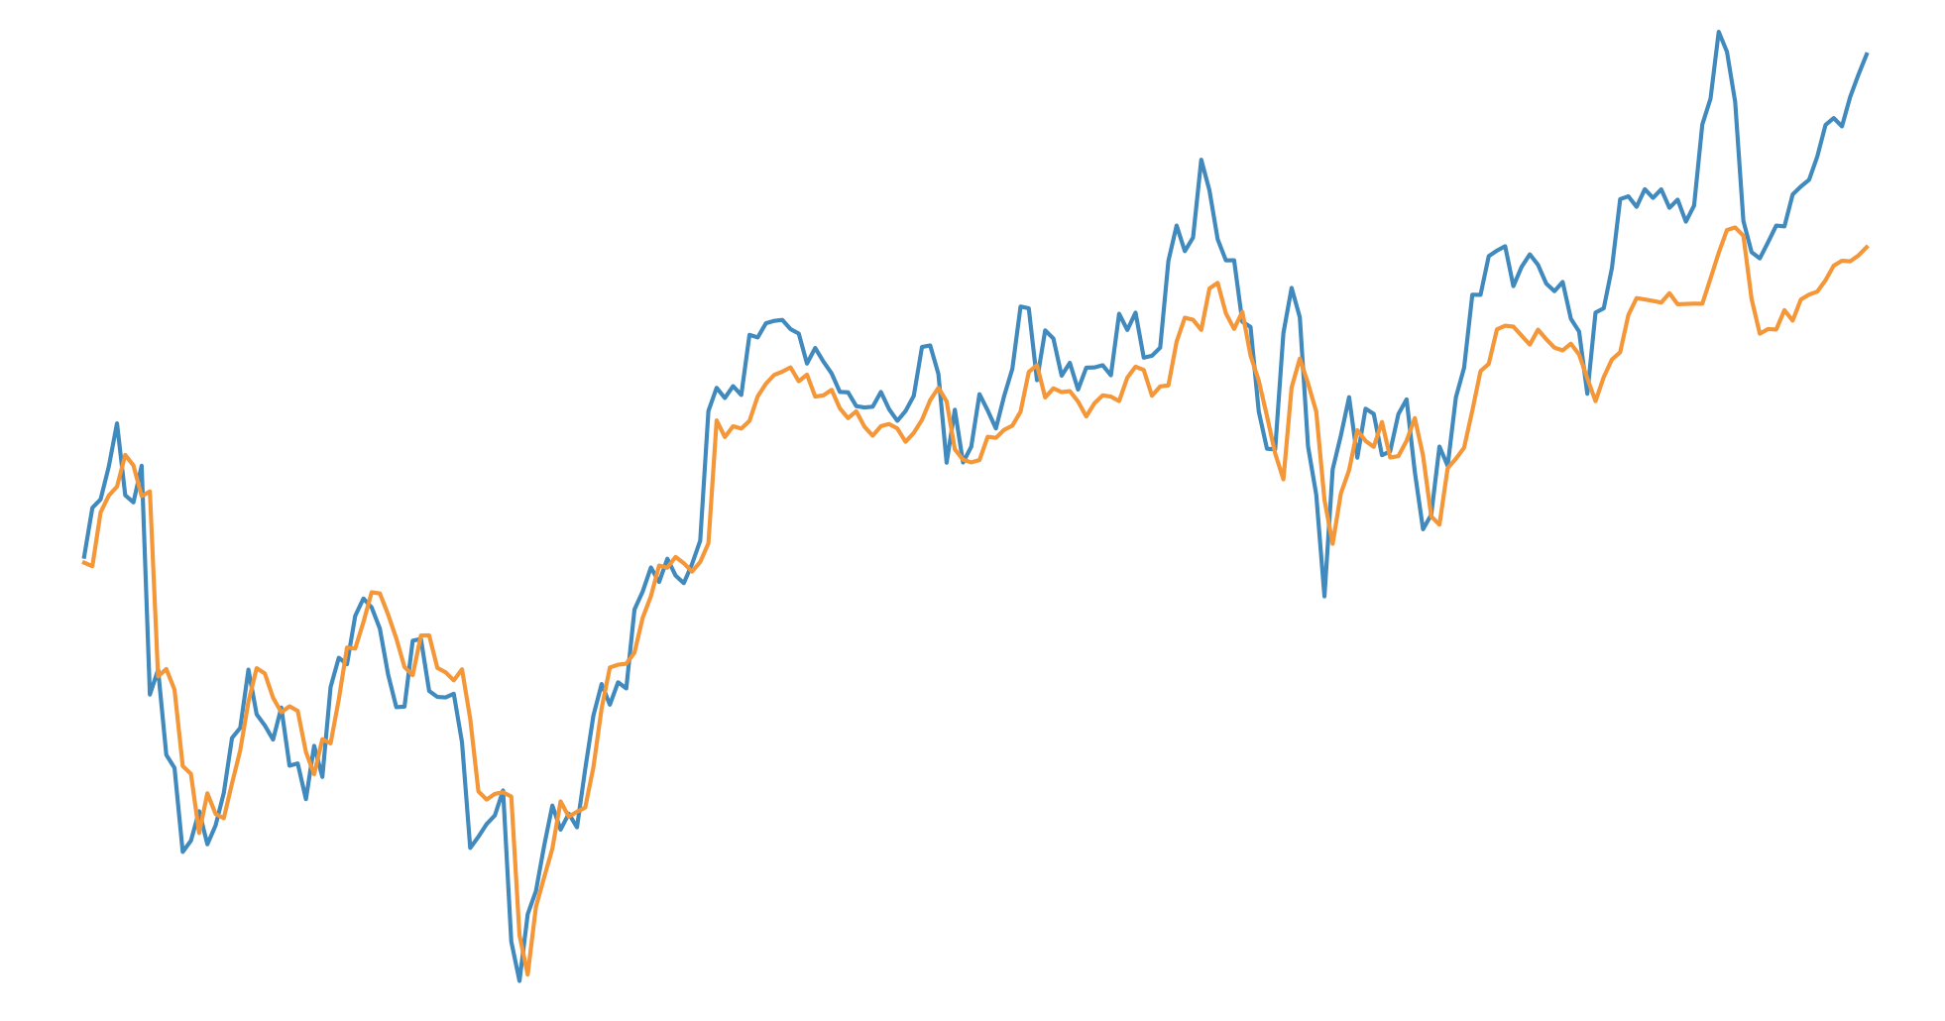

Lab 12-5
RNN with time series data (stock)
With TF 1.0!
Sung Kim <hunkim+ml@gmail.com>
Code: https://github.com/hunkim/DeepLearningZeroToAll/

Slide 39
https://github.com/hunkim/DeepLearningZeroToAll/tree/master/pytorch
https://github.com/hunkim/DeepLearningZeroToAll/blob/master/pytorch/lab-12-5-stock_prediction.py

Slide 40
Time series data

Slide 41
Time series data
Open | High | Low | Volume | Close
828.659973 | 833.450012 | 828.349976 | 1247700 | 831.659973
823.02002 | 828.070007 | 821.655029 | 1597800 | 828.070007
819.929993 | 824.400024 | 818.97998 | 1281700 | 824.159973
819.359985 | 823 | 818.469971 | 1304000 | 818.97998
819 | 823 | 816 | 1053600 | 820.450012
816 | 820.958984 | 815.48999 | 1198100 | 819.23999
811.700012 | 815.25 | 809.780029 | 1129100 | 813.669983
809.51001 | 810.659973 | 804.539978 | 989700 | 809.559998
807 | 811.840027 | 803.190002 | 1155300 | 808.380005
'data-02-stock_daily.csv'

Slide 42
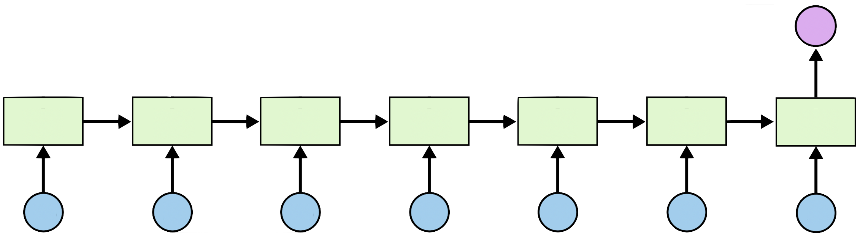
Many to one
8
1
2
3
4
5
6
7

Slide 43
Open | High | Low | Volume | Close
828.659973 | 833.450012 | 828.349976 | 1247700 | 831.659973
823.02002 | 828.070007 | 821.655029 | 1597800 | 828.070007
819.929993 | 824.400024 | 818.97998 | 1281700 | 824.159973
819.359985 | 823 | 818.469971 | 1304000 | 818.97998
819 | 823 | 816 | 1053600 | 820.450012
816 | 820.958984 | 815.48999 | 1198100 | 819.23999
811.700012 | 815.25 | 809.780029 | 1129100 | 813.669983
809.51001 | 810.659973 | 804.539978 | 989700 | ?
807 | 811.840027 | 803.190002 | 1155300 | ?

Slide 44
Reading data
timesteps = seq_length = 7
input_size = 5
num_layers = 1 # number of layers in RNN
# Open,High,Low,Close,Volume
xy = np.loadtxt('data-02-stock_daily.csv', delimiter=',')
xy = xy[::-1] # reverse order (chronically ordered)
xy = MinMaxScaler(xy)
x = xy
y = xy[:, [-1]] # Close as label
dataX = []
dataY = []
for i in range(0, len(y) - seq_length):
_x = x[i:i + seq_length]
_y = y[i + seq_length] # Next close price
print(_x, "->", _y)
dataX.append(_x)
dataY.append(_y)
[[ 0.18667876 0.20948057 0.20878184 0. 0.21744815]
[ 0.30697388 0.31463414 0.21899367 0.01247647 0.21698189]
[ 0.21914211 0.26390721 0.2246864 0.45632338 0.22496747]
[ 0.23312993 0.23641916 0.16268272 0.57017119 0.14744274]
[ 0.13431201 0.15175877 0.11617252 0.39380658 0.13289962]
[ 0.13973232 0.17060429 0.15860382 0.28173344 0.18171679]
[ 0.18933069 0.20057799 0.19187983 0.29783096 0.2086465 ]]
--> [ 0.14106001]
https://github.com/hunkim/DeepLearningZeroToAll/blob/master/pytorch/lab-12-5-stock_prediction.py

Slide 45
Train/Test split
# split to train and testing
train_size = int(len(dataY) * 0.7)
test_size = len(dataY) - train_size
trainX = torch.Tensor(np.array(dataX[0:train_size]))
trainX = Variable(trainX)
testX = torch.Tensor(np.array(dataX[train_size:len(dataX)]))
testX = Variable(testX)
trainY = torch.Tensor(np.array(dataY[0:train_size]))
trainY = Variable(trainY)
testY = torch.Tensor(np.array(dataY[train_size:len(dataY)]))
testY = Variable(testY)
https://github.com/hunkim/DeepLearningZeroToAll/blob/master/pytorch/lab-12-5-stock_prediction.py

Slide 46
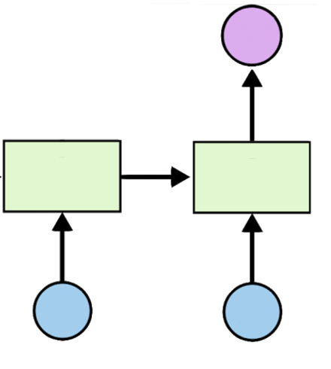
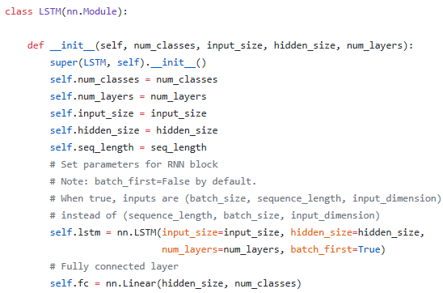
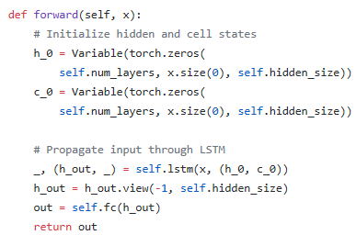
LSTM
https://github.com/hunkim/DeepLearningZeroToAll/blob/master/pytorch/lab-12-5-stock_prediction.py

Slide 47
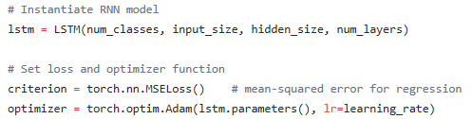
Loss, Optimizer
https://github.com/hunkim/DeepLearningZeroToAll/blob/master/pytorch/lab-12-5-stock_prediction.py

Slide 48
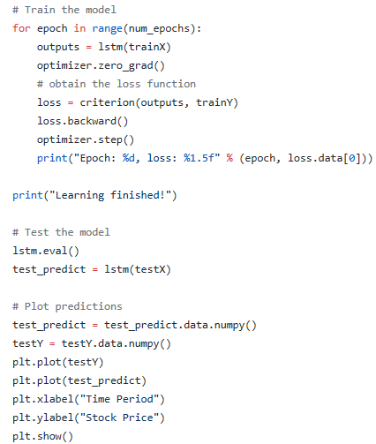
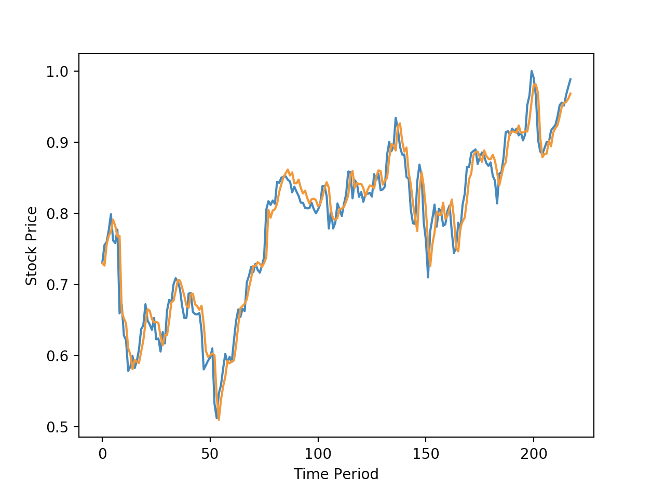
Training and Results
https://github.com/hunkim/DeepLearningZeroToAll/blob/master/pytorch/lab-12-5-stock_prediction.py

Slide 49
Exercise
Implement stock prediction using linear regression only
Improve results using more features such as keywords and/or sentiments in top news

Slide 50
Other RNN applications
Language Modeling
Speech Recognition
Machine Translation
Conversation Modeling/Question Answering
Image/Video Captioning
Image/Music/Dance Generation
http://jiwonkim.org/awesome-rnn/

